Slide 1

Capstone Project Presentation on Airbnb Booking Analysis
Presented by : 1. Gyana Ranjan Dash
2. Rahul Sharma
3. Anis Bagwan
4. Priyabrata Mohanty

Slide 2
Agenda
Problem statement
Objective
Data summary
Data cleaning
Key Findings
Conclusion
Recommendations
Appendix
Data Sources
Data Assumptions

Slide 3
Problem statement
To analyze the past data of Airbnb and deliver valuable insights to the Company.

Slide 4
Objective
Improve our shared understanding about the market condition
Improve our shared understanding about the customer preferences
Provide early recommendation to the Airbnb company.

Slide 5
Data summary
The dataset span over 2 years - 2018 and 2019
The dataset contains 16 features and 48895 observations
Important features:-
Host_id - unique id given to every host by Airbnb
neighbourhood _group and neighbourhood - Place where the property is listed
Price - price of the listed room
Room_type - The type of room listed i.e Entire home/apt , private room, shared room
Minimum_nights - It is the minimum number of nights the property has to be booked for.
Number of reviews - It indicates the total number of reviews for a particular property.

Slide 6
Data cleaning
The columns like last_review and reviews_per_month contains more
than 20% of null values which needs to treated.
For project the few columns are irrelevant such as name, host_name and last_review.
For the column reviews_per_month we can impute the null values with 0.
After looking into price column we can see 95% of data lies below $400 but the max in $10000. So we removed the top 5% of the data for better visualization.

Slide 7
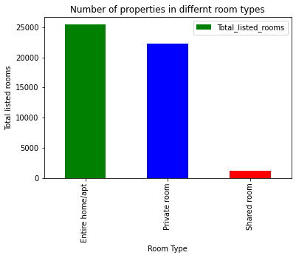
Number of properties
From the above bar plot
we can clearly see that entire home or apartment is more
highest in number where
as the number of shared
room is very less .

Slide 8
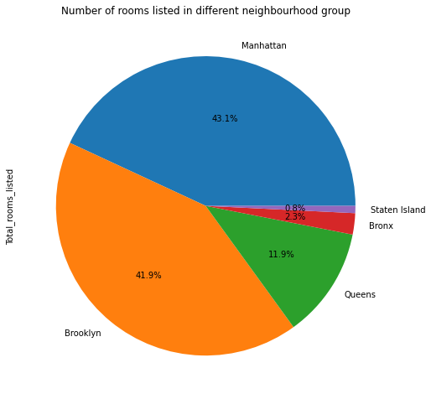
Rooms in Neighbourhood
From the above pie chart
the following instances
we can conclude that :
Manhattan and Brooklyn have most number of rooms, together have more than 85% of total rooms available.
Manhattan has highest number of rooms which is more than 44%.
Staten Island has lowest number of rooms which is less than 10%.

Slide 9
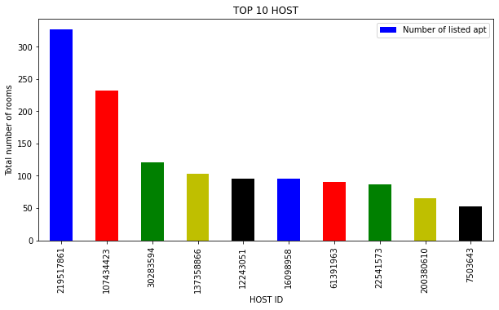
Top 10 Hosts
Following bar plot shows the hosts with maximum number of rooms listed on their name.
X-axis shows the individual ID’s of hosts.
Y-axis shows the number of rooms listed for corresponding host.

Slide 10
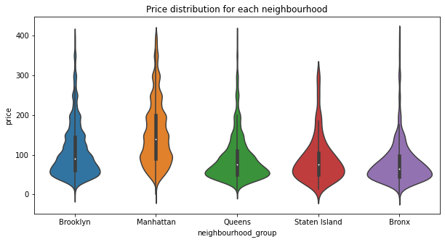
Price Distribution
In the above figure we can see the distribution of prices of properties in different neighbourhood group.
We can clearly see that manhattan have more premium properties.
Bronx , staten island and queens have reasonable prices as compared to the manhattan and brooklyn.

Slide 11
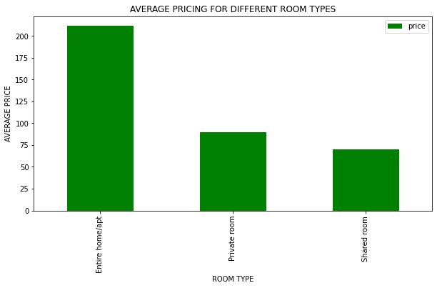
Average prices of rooms
We can clearly see the average price of entire home or apartment is much higher than any other room types.
The average price of Shared room is very low.
It seems obvious as the entire home or apartment tend to have higher pricing than a shared room.

Slide 12
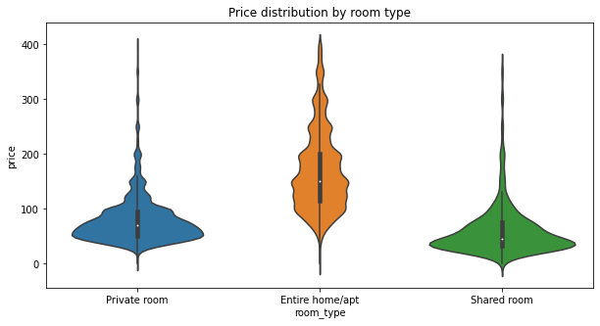
Price Distribution by
room type
As expected, shared rooms have the lowest mean price, while entire homes have the highest.
All room types seem to have a similar spread, however private rooms and shared rooms seemed to be more centered around their mean.

Slide 13
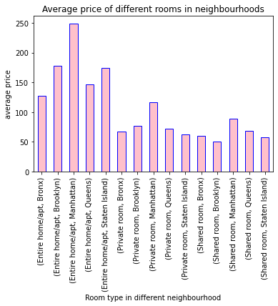
Expensive place to rent
From the lateral plot we can say :
The average price of Entire room/apt in Manhattan is higher than any other in neighborhood
The average price of shared room in Manhattan is higher than any other neighborhoods.
The average price of shared room in Manhattan is higher than any other neighborhood.
From the above insights we can conclude that the Manhattan is a expensive place to rent property in any category.

Slide 14
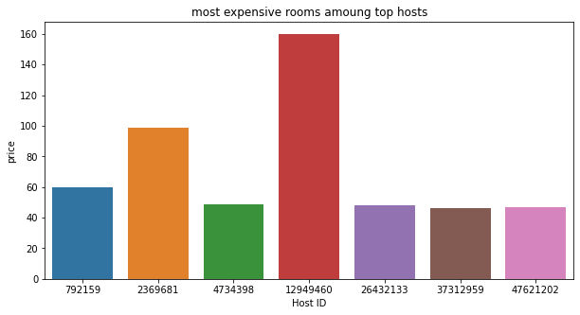
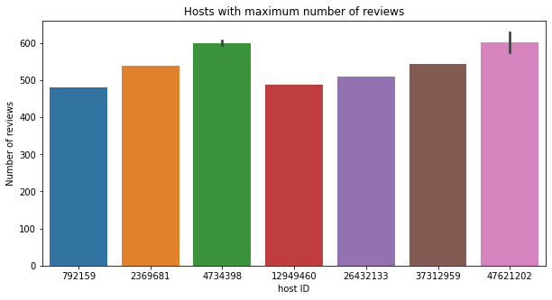
Rooms and Reviews
The host with Host ID 12949460 list’s most expensive room but the same ID have less no of reviews compared to other reviews.
The hosts which are not that much expensive have maximum number of reviews.

Slide 15
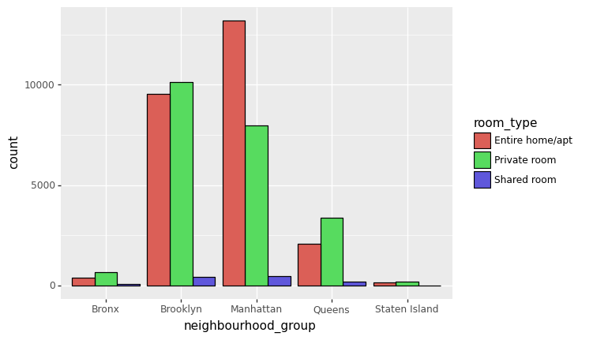
Most preferable room types
From the above plot we can draw following insights :
In Manhattan the number of listed Entire home/apt is much higher than any other room type.
In Brooklyn the number of Private Room is slightly higher than Entire home/apt.
In Queens the total number of listed Private Rooms is much higher than the any other room type.
In Bronx and Staten Island the number of rooms in all the category are almost same.
From the above insights we can conclude that the people prefer to live in Entire home/apt in Manhattan.

Slide 16
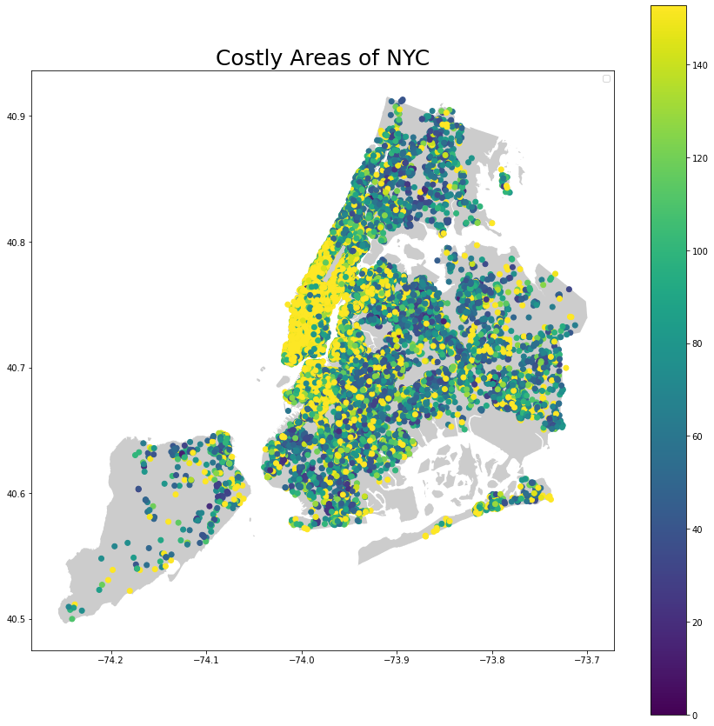
Costly areas
Yellow dots represents the places where the properties are costly.
Blue dots represents the places where the properties are comparatively cheaper.
The place where we can see high concentration of yellow dots is the most costly region in NYC

Slide 17
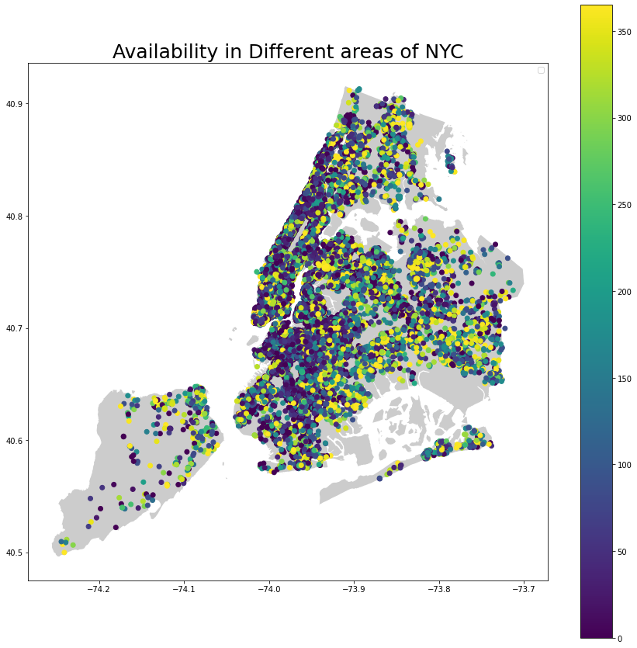
Availability in areas of NYC
When we compare two graphs we can say that most costly places are also a cluster of considerable number of rooms availabilities as well.
The empty spots on the maps are the opportunities to expand and enroll new hosts from there.

Slide 18
Conclusion
Manhattan and Brooklyn are the prime locations with highest number of rooms
Manhattan is the most expensive place to rent a room
Customers prefer Entire home/ apt more
Properties which are expensive tend to attract less number of customers.

Slide 19
Recommendations
Increase the listing of private rooms in Queens and Manhattan.
Try to keep Minimum number of nights below 7 days.
Keep avg price of the private rooms in Queens and Manhattan low.

Slide 20
Appendix - Data sources
Here is a snapshot of data dictionary.
Property information such as
Name, neighbourhood, price, availability and reviews
Host information such as
Host ID, host name
We used the past dataset from 2018 and 2019

Slide 21
Appendix - Data Methodology
We conducted a thorough analysis of the Airbnb-NYC dataset. The process includes
Data cleaning - Discard irrelevant columns and null imputation
Correlation -Finding correlation between the different parameters
EDA - Understanding data using different methods

